Slide 1
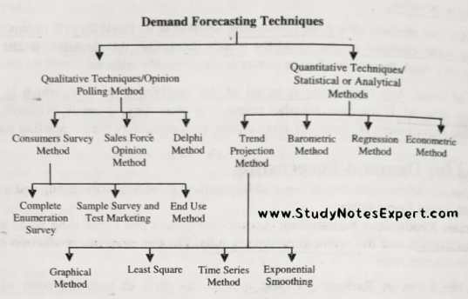


Demand Forecasting :- Demand forecasting allows manufacturing companies to gain insight into what their consumer needs through a variety of forecasting methods. These methods include: predictive analysis, conjoint analysis, client intent surveys, and the Delphi Method of forecasting.

Slide 2
Moving Average:- A moving average is defined as an average of fixed number of items in the time series which move through the series by dropping the top items of the previous averaged group and adding the next in each successive average.
Time (Week) | Sales | MA |  | Error | SquerError | Persentage Error | Abs.Per.Error
1 | 17
2 | 21
3 | 19
4 | 23 | 19 |  | 4 | 16 | 0.173913043 | 0.173913043
5 | 18 | 21 |  | -3 | 9 | -0.166666667 | 0.166666667
6 | 16 | 20 |  | -4 | 16 | -0.25 | 0.25
7 | 20 | 19 |  | 1 | 1 | 0.05 | 0.05
8 | 18 | 18 |  | 0 | 0 | 0 | 0
9 | 22 | 18 |  | 4 | 16 | 0.181818182 | 0.181818182
10 | 20 | 20 |  | 0 | 0 | 0 | 0
11 | 15 | 20 |  | -5 | 25 | -0.333333333 | 0.333333333
12 | 22 | 19 |  | 3 | 9 | 0.136363636 | 0.136363636
 |  | 19 |  | 0 | 10.22222222 | -0.023100571 | 0.023100571
 |  |  |  | Mean Error | MSE | MPE | MAPE

Slide 3
Graphical

Slide 4
Exponential Smoothing:- Exponential smoothing is a method for forecasting univariate time series data. It is based on the principle that a prediction is a weighted linear sum of past observations or lags. The Exponential Smoothing time series method works by assigning exponentially decreasing weights for past observations.
1 | 17
2 | 21 | 17 | 17 | 4 | 16 | 0.19047619 | 0.19047619
3 | 19 | 17.8 | 17.8 | 1.2 | 1.44 | 0.063157895 | 0.063157895
4 | 23 | 18.04 | 18.04 | 4.96 | 24.6016 | 0.215652174 | 0.215652174
5 | 18 | 19.032 | 19.032 | -1.032 | 1.065024 | -0.057333333 | 0.057333333
6 | 16 | 18.8256 | 18.8256 | -2.8256 | 7.98401536 | -0.1766 | 0.1766
7 | 20 | 18.26048 | 18.26048 | 1.73952 | 3.02592983 | 0.086976 | 0.086976
8 | 18 | 18.608384 | 18.608384 | -0.60838 | 0.370131091 | -0.033799111 | 0.033799111
9 | 22 | 18.4867072 | 18.4867072 | 3.513293 | 12.3432263 | 0.159695127 | 0.159695127
10 | 20 | 19.18936576 | 19.18936576 | 0.810634 | 0.657127871 | 0.040531712 | 0.040531712
11 | 15 | 19.35149261 | 19.35149261 | -4.35149 | 18.93548792 | -0.290099507 | 0.290099507
12 | 22 | 18.48119409 | 18.48119409 | 3.518806 | 12.38199506 | 0.159945723 | 0.159945723
 |  | Average | Average | 0.993161 | 8.982230675 | 0.032600261 | 0.134024252
 |  |  |  | Mean Error | MSE | MPE | MAPE
Alpha= | 0.2
Forecasting Formula Ft = |  | At-1*α+(1-α)*Ft-1 | At-1*α+(1-α)*Ft-1
At-1= Previous actual demand |  |  |  |  | 1-α =Damping Factor
Ft-1= Previous period Forecast
alpha= smoothing constant
Ft= New Forecast

Slide 5
Graphical Represent

Slide 6
Trend Analysis:- The trend is the component of a time series that represents variations of low frequency in a time series, the high and medium frequency fluctuations having been filtered out.
Year | Period(X) | Power Demand | Trend Forecast
2010 | 1 | 74 | 67.25
2011 | 2 | 79 | 77.79
2012 | 3 | 80 | 88.32
2013 | 4 | 90 | 98.86
2014 | 5 | 105 | 109.39
2015 | 6 | 142 | 119.93
2016 | 7 | 122 | 130.46
2017 | 8 |  | 141.00
Intercept | 56.71428571 |  | Y=B+AX
Slope | 10.53571429
 |  | Forecast Equation | Y=56.72+10.54X
B= Intercept
A= Slope

Slide 7
Graphical Represent

Slide 8
Before forecast power demand

Slide 9
Linear regression :- Linear regression is a statistical tool used to help predict future values from past values. It is commonly used as a quantitative way to determine the underlying trend and when prices are overextended
1 | Jan-22 | 70 | 79.9965035
2 | Feb-22 | 84 | 80.62937063
3 | Mar-22 | 76 | 81.26223776
4 | Apr-22 | 84 | 81.8951049
5 | May-22 | 85 | 82.52797203
6 | Jun-22 | 67 | 83.16083916
7 | Jul-22 | 82 | 83.79370629
8 | Aug-22 | 66 | 84.42657343
9 | Sep-22 | 66 | 85.05944056
10 | Oct-22 | 76 | 85.69230769
11 | Nov-22 | 70 | 86.32517483
12 | Dec-22 | 77 | 86.95804196
Equation | Y=mx+c
Slope | 0.633
Intercept | 79.36

Slide 10
Graphical Reprsent

Slide 11
Observation :-
Find Error for best Model
Alpha can different for different product and season.
Trend Analysis are work on Time Series
But linear regression work on Associativity Method
Linear regression work on relation between variable

